Slide 1
Pumping lemma, homomorphism, inverse, test discussion
Dr G Sudha Sadasivam

Slide 2
Statement of the Pumping Lemma
Not a regular language
Number of
states of
DFA for L
For every regular language L
There is an integer n, such that
For every string w in L of length > n
We can write w = xyz such that:
|xy| < n.
|y| > 0.
For all i > 0, xy^{i}z is in L.
Labels along
first cycle on
path labeled w

Slide 3
Example: Use of Pumping Lemma
We have claimed {0^{k}1^{k} | k > 1} is not a regular language.
Suppose it were. Then there would be an associated n for the pumping lemma.
Let w = 0^{n}1^{n}. We can write w = xyz, where x and y consist of 0’s, and y ≠ ε.
But then xyyz would be in L, and this string has more 0’s than 1’s.

Slide 4
0^{n} 1^{n-k}1^{k} = 0^{n} 1^{n}
Results in more or less no of 1’s than 0’s
So it does not result in language 0^{n} 1^{n}
Not regular
Add / del 1

Slide 5
Ex 2 – PT (ab)^{2n} is not regular
w = xyz
x as (ab)² ; y as (ab)^{2n-2} z is ɛ
such that:
|xy| < n.
|y| > 0.
For all i > 0, xy^{i}z is in L
Now insert i=1 now y is (ab)^{2n-2+1} = (ab)^{2n-1} ; w= (ab)² (ab)^{2n-1} = (ab)^{2n+1} it does not belong to the language

Slide 6
Homomorphism
A homomorphism on an alphabet is a function that gives a string for each symbol in that alphabet.
Example: h(0) = ab; h(1) = ε.
So h(01010) = ababab
If L is a regular language, and h is a homomorphism on its alphabet, then h(L) = {h(w) | w is in L} is also a regular language.
Proof: Let E be a regular expression for L.
Apply h to each symbol in E.
Language of resulting RE is h(L).
Eg: 01* →(ab) ε*→ ab

Slide 7
Ex2: Let h(0) = ab; h(1) = ε.
Let L be the language of regular expression 01* + 10*.
Then h(L) is the language of regular expression
abε* + ε(ab)*.
→ ab + (ab)*
→ (ab)* as ab is contained in (ab)*

Slide 8
Inverse Homomorphism
Let h be a homomorphism and L a language whose alphabet is the output language of h.
h⁻¹(L) = {w | h(w) is in L}.
Let h(0) = ab; h(1) = ε.
Let L = {abab}.
h⁻¹(L) = the language with two 0’s and any number of 1’s = L(1*01*01*).

Slide 9
Example: Inverse Homomorphism Construction
a
1
Since
h(1) = ε
B
B
1
a
A
b
A
0
b
b
0
Since
h(0) = ab
C
C
a
1
, 0
h(0) = ab
h(1) = ε

Slide 10
Proof – (3)
Induction on |w| shows that δ_{B}(q₀, w) = δ_{A}(q₀, h(w)).
Basis: w = ε.
δ_{B}(q₀, ε) = q₀, and δ_{A}(q₀, h(ε)) = δ_{A}(q₀, ε) = q₀.
Induction: Let w = xa; assume inverse homomorphic for x.
δ_{B}(q₀, w) = δ_{B}(δ_{B}(q₀, x), a).
= δ_{B}(δ_{A}(q₀, h(x)), a) by the IH.
= δ_{A}(δ_{A}(q₀, h(x)), h(a)) by definition of the DFA B.
= δ_{A}(q₀, h(x)h(a)) by definition of the extended delta.
= δ_{A}(q₀, h(w)) by def. of homomorphism

Slide 11

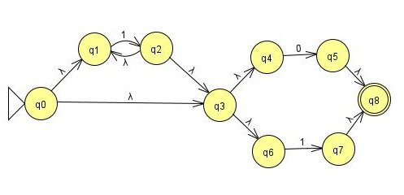
CA test1
Formal definition of NFA; 2 differences
1* (0|1)
ϵ-cl(q0)={q0,q1,q3,q4,q6}=A;
δ(A,0)= ϵ-cl(q5)={q5, q8} = B*
δ(A,1)= ϵ-cl(q2,q7)={q2, q3,q4,q6,q1,q7,q8} = C*

Slide 12
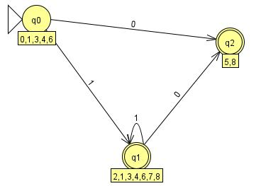
DFA
 | 0 | 1
Q0 | Q2 | Q1
Q1 | Q2 | Q1
Q2 | Ⴔ | Ⴔ
{q0} and {q1,q2} AGAIN SPLIT q1 and q2
Same DFA

Slide 13
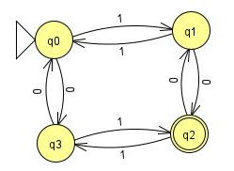
Intersection
Remove q1
Remove q3
((11+00)*(10+01)(00+11)*(01+10))*(11+00)*(10+01)(00+11)*
11
q0
10
01
q3
q2
00
11+00
q0
10+01
01+10
q2
00+11

Slide 14
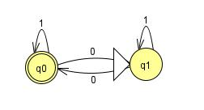
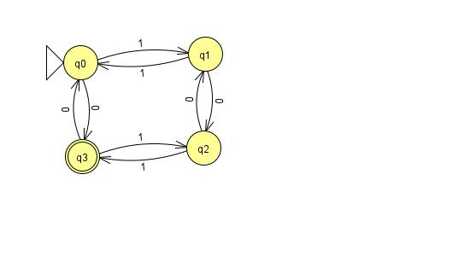
Reversal
(1*01*0)*1*01*
Difference
(11+1001)* (101+0) (11)*
((101+0) (11+1001)* (101+0) (11)*)*

